Slide 1
NavPath Modeling
Golam Md Muktadir

Slide 2
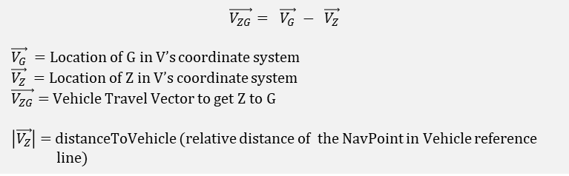
Goal: The pedestrian, P, needs to arrive at N, and the vehicle front, V needs to arrive at G at the same time.
N
G
N: NavPoint Physical Location
G: Projection of NavPoint, N, on vehicle reference line (the line vehicle follows to travel)
Z: Point at distanceToEgo from current V
P
Z
V
V: Vehicle Reference Point
$$\vec{V_{ZG}}= \vec{V_{G}} − \vec{V_{Z}}$$
$\vec{V_{G}}$ = Location of G in V’s coordinate system
$\vec{V_{Z}}$ = Location of Z in V’s coordinate system
$\vec{V_{ZG}}$ = Vehicle Travel Vector to get Z to G
$\left|\vec{V_{Z}}\right|$ = distanceToVehicle (relative distance of the NavPoint in Vehicle reference
line)

Slide 3



When distanceToEgo > 0 (Z is in front of the vehicle)
Case #1: $\vec{V_{ZG}} ∙\vec{V_{Z}}$ > 0
Z is behind G
Case #2: $|\vec{V_{ZG}}|$ = 0
Z is on G
Case #2: $\vec{V_{ZG}} ∙\vec{V_{Z}}$ < 0
Z is beyond G. Overshoot
N
G
N
G
Z
Z
V
Z
V
V
N
G
Vehicle reference point is at the front of the vehicle

Slide 4



When distanceToEgo < 0 (Z is behind the vehicle)
Case #1: $\vec{V_{G}} ∙\vec{V_{Z}}$ < 0
Z is behind G
Case #1: $|\vec{V_{ZG}}|$ = 0
Z is on G
Case #1: $\vec{V_{G}} ∙\vec{V_{Z}}$ > 0
Z is beyond G. Overshoot
N
G
V
V
V
Z
N
G
Z
N
G
Z
Vehicle reference point is at the back of the vehicle

Slide 5
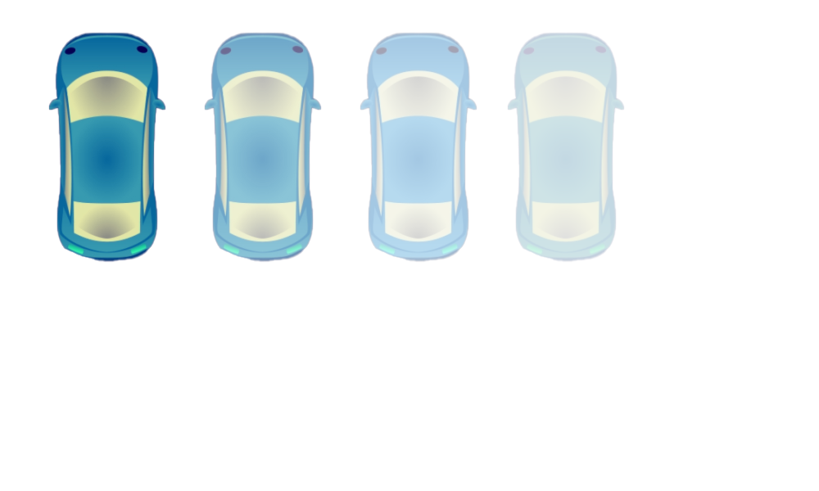
4
4
4
4
3
4
3
3
2
3
2
3
2
3
3
2
25
meter
1
1
1
1
2
2
2
2
1
1
1
1
(a)
(b)
(c)
(d)
Fig. 1: PSI 2.0, Video 0019. (a) In a 4-lane unidirectional road, the vehicle drives along the second lane from the left at 20 mph. The pedestrian walks over 10 meter along the right lane of the vehicle in a wavering fasion and suddenly stops crossing in front of the vehicle. (b) Existing simulation models’s low expressiveness and limitation in capturing spatial and temporal variance produces simple behaviors. The circular area shows the trajectory envelope. (c) Our modeling approach captures the behavior and produces variations.

Slide 6
5
4
4
4
4
4
4
4
4
3
3
3
3
3
2
3
2
3
2
3
2
1
1
1
1
2
2
2
2
1
1
1
1

Slide 7
5
4
4
4
4
4
4
4
4
3
3
3
3
3
2
3
2
3
2
3
2
1
1
1
1
2
2
2
2
1
1
1
1

Slide 8
Lane Id -1
Lane Id 0
Lane Id 1
4
4
P
3
3
2
L
M
R
L
M
R
25 meter
1
Distance
to Ego
2
1

Slide 9
Lane Id -1
Lane Id 0
Lane Id 1
4
4
P
3
(-1, R, d)
3
2
L
M
R
L
M
R
L
M
R
25 meter
1
2
Distance to Ego: d
Left Section
Middle Section
Right Section
1
Distance
to Ego

Slide 10
Behavior Matcher

Slide 11
Flinch
4
4
3
3
2
1
2
1

Slide 12
Flinch
P
C
N
Flinch 1
Flinch 2
P
P
C
N
C
N

Slide 13
Flinch
P
Flinch 1
Flinch 2
N
C
P
P
C
N
C
N
Retreat 1
Retreat 2
P
C
P
C
N
N
Flinch 1
Flinch 2
Retreat
P
P
C
N
P
C
N
C
N

Slide 14
Slow down speedup
P
C
N
Stop:
V_c ~ 0 m/s
Speedup:
V_n > V_c
Slowdown:
V_n < V_c
P
C
C
N
C
N

